Slide 1
The Golden Age Of Aircraft Design
AVIONICS from Early Days till Now
Maria Bychkova
BMSTU MT11-83
Moscow 2014

Slide 2

Contents
1) Definition of avionics
2) History of the development
3) Modern avionics
4) Communications
5) Navigation systems
6) Monitoring

Slide 3
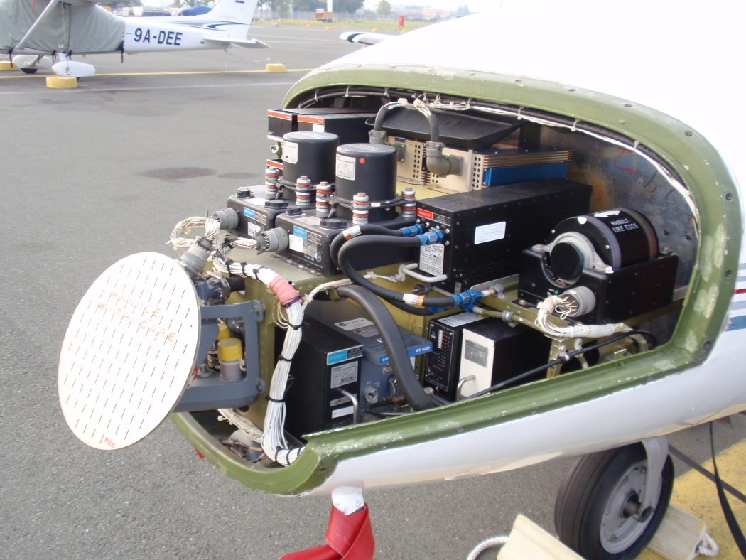
Definition
Avionics
aviation
electronics
electronic systems
used on aircraft,
artificial satellites
and spacecraft

Slide 4

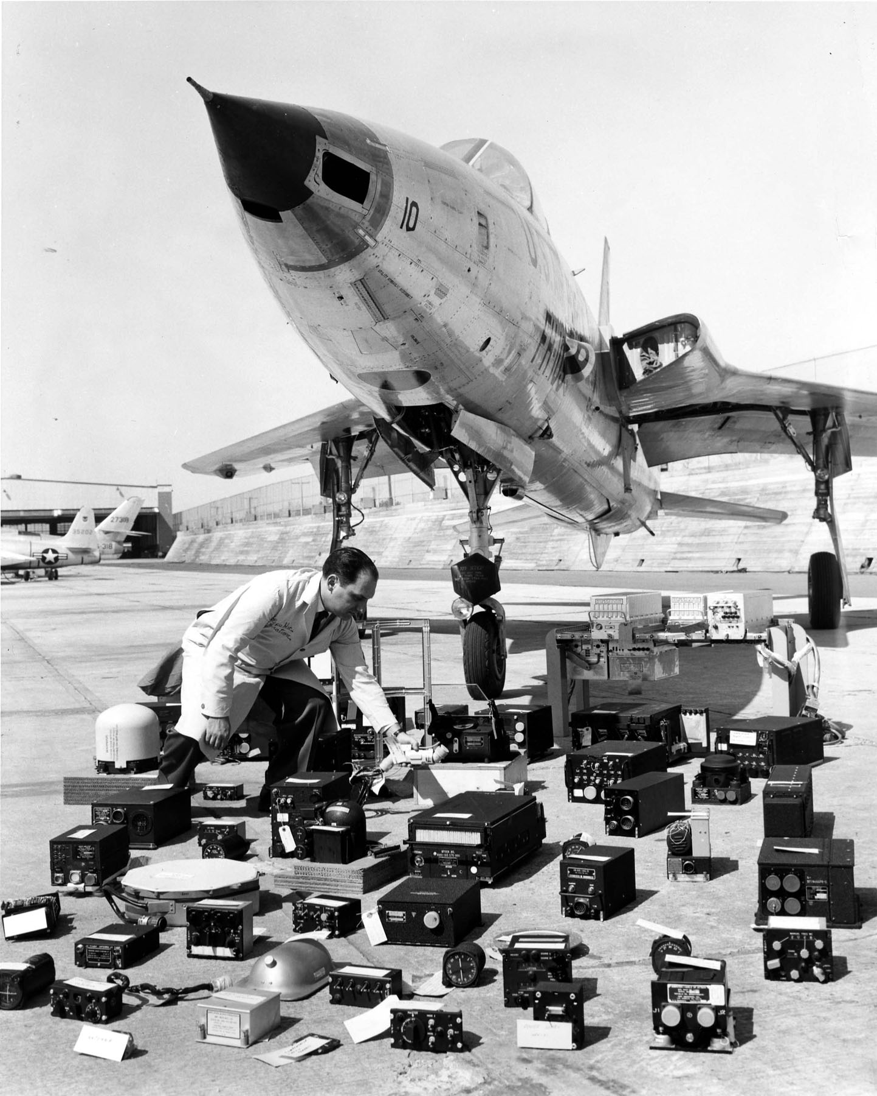
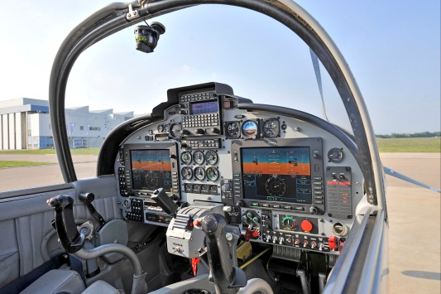
History
a barometer
an anemometer
magnetic compasses
fuel-quantity gauges
altitude
airspeed
heading
fuel levels
18th century
to measure
1920s
first blind flight and landing
1930s
radio navigation and landing aids
radar for aircraft detection
VHF
UHF
1940s
(WW2)
communications
autopilots
automated warning systems
integrated flight instruments
1960s
1970s
digital computers
glass cockpits

Slide 5
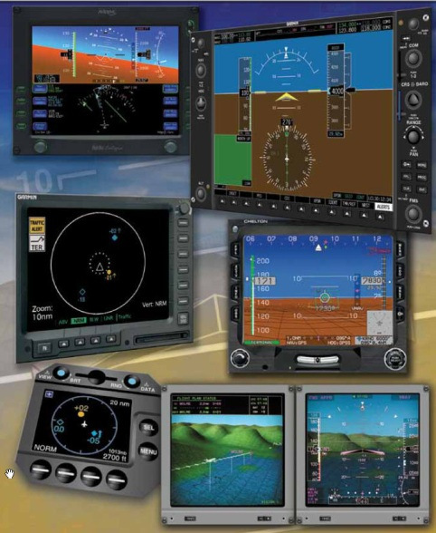
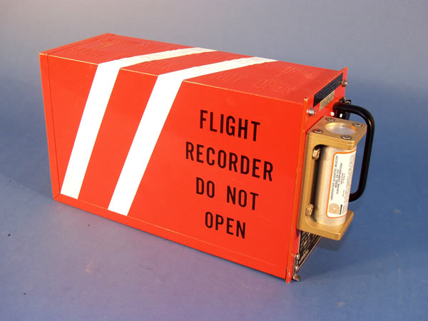

Modern Avionics
Communications
Navigation
Monitoring
Aircraft flight-control systems
Collision-avoidance systems
Black Boxes
Weather systems
Radar
Sonar
Electro-Optics
ESM (Electronic support measures)
DAS (Defensive aids)
Aircraft networks

Slide 6
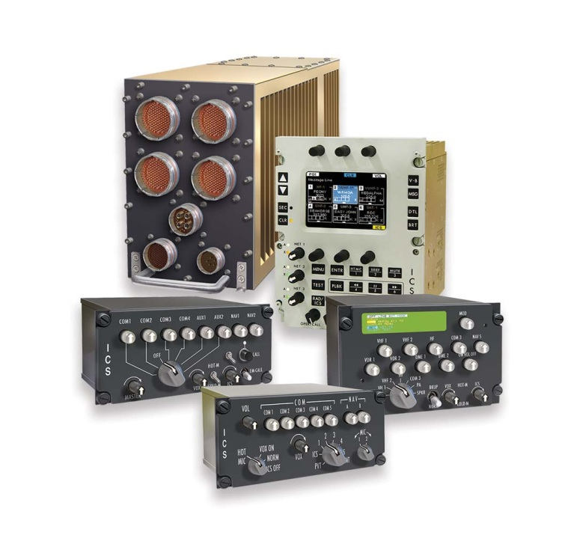
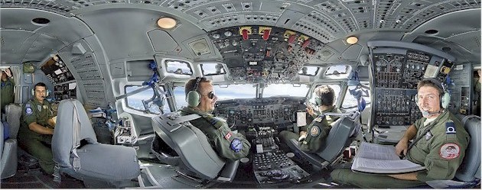
Communications
connect the flight deck to the ground
and to the passengers
The main type
Very High Frequency (VHF) communication systems
controlling air traffic
line of sight communication

Slide 7
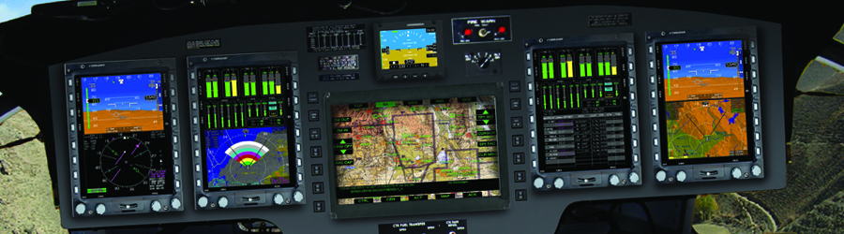
Navigation
Inertial
Navigation
Systems
(INS)
Satellite
Navigation
Systems
(example: GPS)
Radio
Navigation
Systems

Slide 8
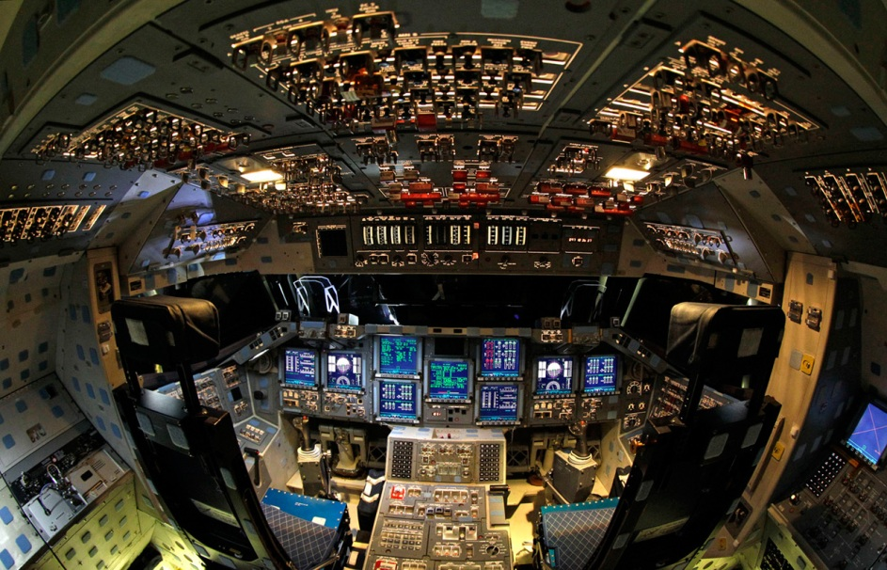
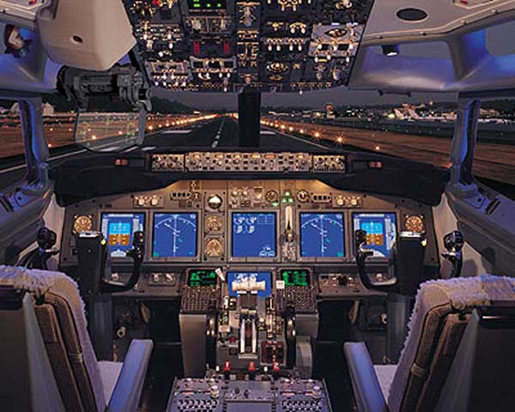
Monitoring
Glass cockpit
space shuttle
airplane
multi-function display
primary flight display
navigation display
mode control panel
engine indicating and crew alerting system

Slide 9

Thank you for your attention!
bychkova_ms@mail.ru

